Slide 1
Mess Management
system
By
Md Mahbub Hasan 161-35-1511
Md Rownak Jahan Tanjil 161-35-1463

Slide 2
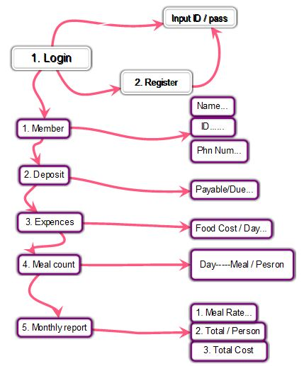
Mind map :

Slide 3
Features
Admin who will be acting as the administrator. members of the mess will be accessing the system. The features that are available to the systems are:
1. Can use the different categories available in the system.
2. Add members and their information in it .
3. Can check the report of months.
4. Can access all the accounts of the members.
5. Can view the List of members.
6. Can input expenses, edit password, login as a new member.

Slide 4
Home
Login
New user
Edit password
Exit

Slide 5
Login
Enter user name
Enter Password

Slide 6
New User
Enter user name
Enter Password
Re-Enter password

Slide 7
Edit password
Enter Old Password
Enter New Password
Re-Enter New password

Slide 8
Add Member
Enter ID
Enter Name
Enter mobile No.
Enter Religion
Enter Occupation
Enter Debit
Total Member=
Want add more(y/n)

Slide 9
Expenses
Enter Total cost
Enter Name
Want add more(y/n)

Slide 10
meal count
ID Name Meal
1 shakil 2
2 Foysal 3
4 Jami 2
3 Tanjil 4
7 Mitul 1

Slide 11
Monthly report
Expenses details
-------------------------------
Total meal Total cost
Meal rate Total member
ID Name Meal Bill Due/Payable
1 Shakil 10 1200 500
Go Home Enter ‘H’

Slide 12
Thank you

